Slide 1
A Case for Stateful Forwarding Plane(Smart Flooding)
NDN, Technical Report NDN-0002, 2012. http://named-data.net/techreports.html
Cheng Yi, Alexander Afanasyev, Ilya Moiseenko, Lan Wang, Beichuan Zhang, Lixia Zhang

Slide 2
Forwarding Mechanism紹介
IP Internet
routing plane: routers exchange routing updates and select the best routes to construct the forwarding table (FIB) SMART
forwarding plane: routers forward packets strictly following the FIB DUMB
NDN network
routing plane: serves the same purpose as in an IP network
forwarding plane:
consumers first send out Interest packets; Data packets flow back along the same path in the reverse direction
Routers keep state of pending Interests

Slide 3
Benefits of NDN’s forwarding plane紹介
Built-in network caching and multicast data delivery
Adaptive forwarding enabled by the state maintained at routers.
measure packet delivery performance (e.g., round-trip time and throughput)
detect problems that lead to packet losses (e.g., link failures or congestion)
utilize multiple alternative paths to bypass problematic areas.

Slide 4
Forwarding plane of Jacobson’paper紹介
The operations of its forwarding plane are not fully explained and the design specifics remain to be filled in.
[1]V. Jacobson, D. K. Smetters, J. D. Thornton, M. F. Plass,N. H. Briggs, R. L. Braynard, Networking named content, in:Proceedings of ACM CoNEXT, 2009.

Slide 5
Goal in this paper 目的
To explore the design space and identify critical research issues by sketching out an initial design of NDN’s forwarding plane and evaluating its data delivery performance under adverse conditions.

Slide 6
The contributions of this paper発想
A concrete design of NDN’s forwarding plane which includes specific mechanisms for routers to keep track of data delivery performance, control network load, and retry alternative paths.
A new Interest NACK mechanism enable NDN router to perform quick and informed recovery from network problems.

Slide 7
Simulation and Evaluation手法
Scenarios: prefix hijacks, link failures, and network congestion
Compare the performance of our stateful forwarding plane with that of both IP and an IP-based multipath forwarding solution, Path Splicing

Slide 8
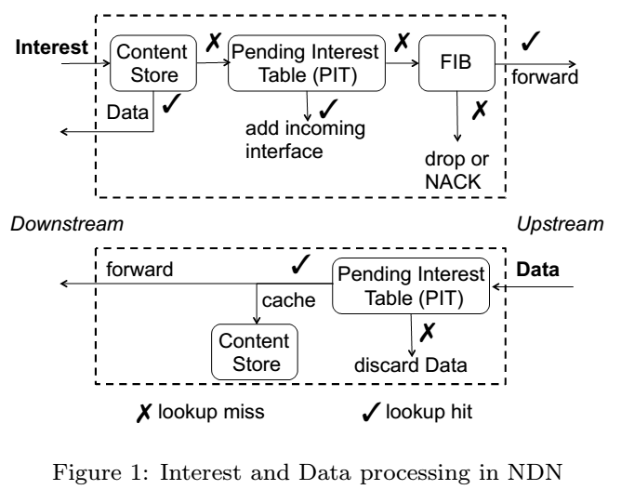
Overview of NDN’s Forwarding Plane

Slide 9
Adaptive Forwarding
To utilize NDN routers’ datagram state to build an intelligent and adaptive forwarding plane.
In the original sketch of NDN [1], routers discover failures by timeout only.
NACK: carries the same name and nonce as the original Interest, plus an error code explaining the reason why the Interest cannot be satisfied or forwarded
Duplicate: The Interest has been received earlier by the upstream node
Congestion: The upstream node has no available interface to forward the Interest.
No Data: The upstream node does not have the requested data and has no path to forward the Interest.

Slide 10
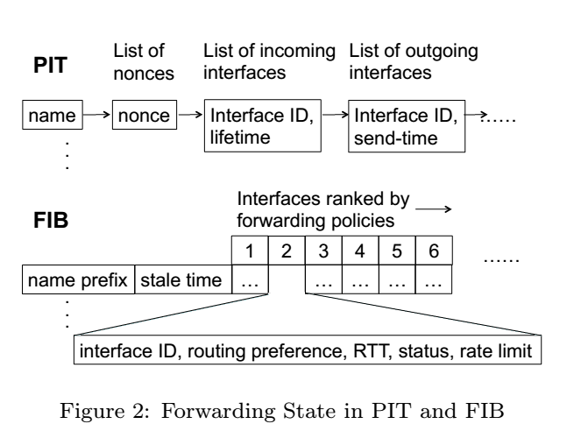
Forwarding State

Slide 11
Status of each interface
Green: the interface is working.
Yellow: the interface may or may not work.
Red: the interface does not work.
Initial status is Yellow
turns Green when Data flows back
A Green interface turns Yellow when a pending Interest times out
An interface is marked Red if it goes down.
Retry Timer(RTT)

Slide 12
Retry-timer
Before the timer expires, subsequent Interests carrying a name that already exists in PIT will be suppressed because the router is still expecting Data to be retrieved by the previously forwarded Interest
After the timer expires, the router will not retry alternative interfaces upon receiving a NACK, to limit the overhead caused by local retry

Slide 13
Interface Ranking
Routing Policies: Nodes Producers
Determine which routes to be available
Forwarding Policies: Nodes Consumers
Determine which route actually get used
Forwarding Policies:
ns3::ndn::fw::Flooding (default)
ns3::ndn::fw::BestRoute
ns3::ndn::fw::SmartFlooding

Slide 14
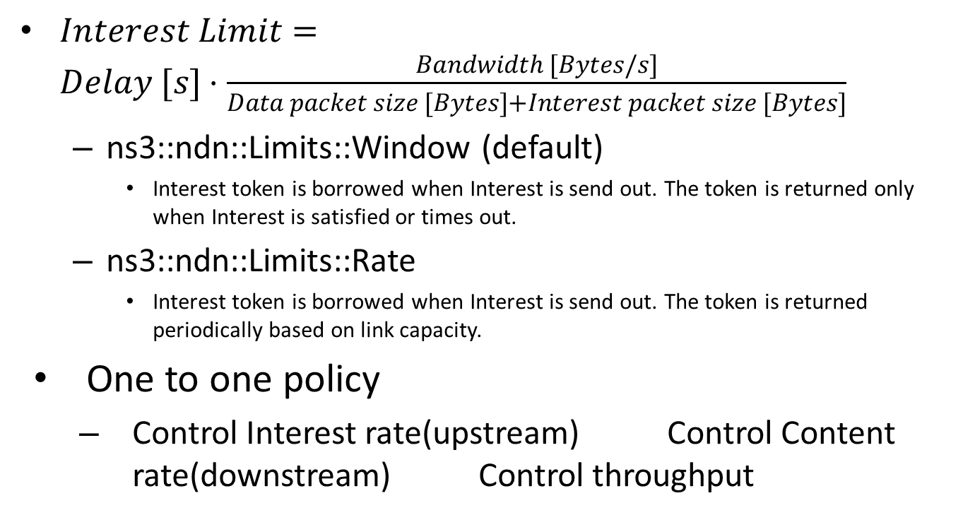
Strategies with Interest limits
$Interest Limit=Delay [s]⋅\frac{Bandwidth [Bytes/s]}{Data packet size [Bytes]+Interest packet size [Bytes]}$
ns3::ndn::Limits::Window (default)
Interest token is borrowed when Interest is send out. The token is returned only when Interest is satisfied or times out.
ns3::ndn::Limits::Rate
Interest token is borrowed when Interest is send out. The token is returned periodically based on link capacity.
One to one policy
Control Interest rate(upstream) Control Content rate(downstream) Control throughput

Slide 15
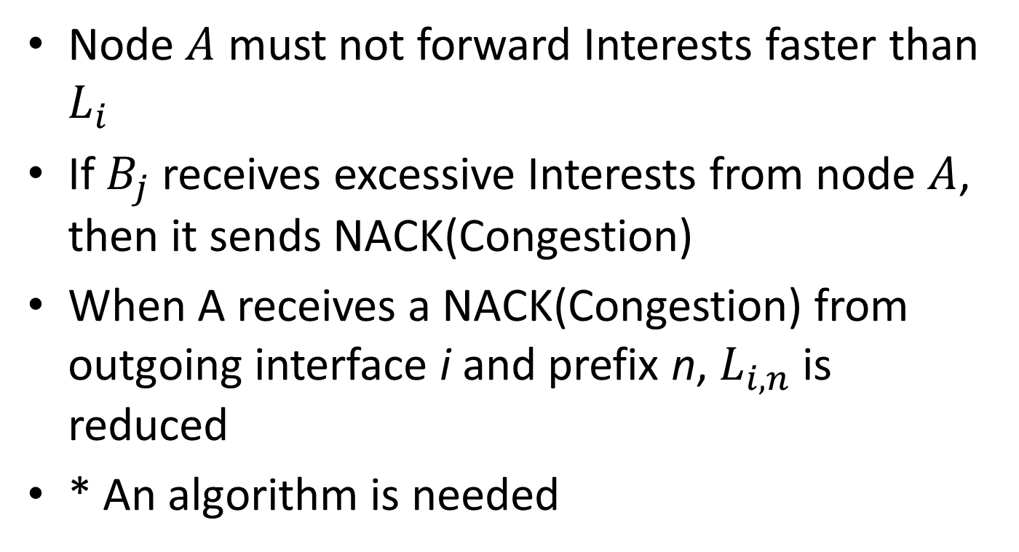
interface i of A to interface j of B
Node $A$ must not forward Interests faster than $L_{i}$
If $B_{j}$ receives excessive Interests from node $A$, then it sends NACK(Congestion)
When A receives a NACK(Congestion) from outgoing interface i and prefix n, $L_{i,n}$ is reduced
* An algorithm is needed

Slide 16
Overall Interest processing mechanism

Slide 17
Simulation
Three fault scenarios:
(1) prefix hijack, in which an attacker announces the victim’s prefix and drops the traffic;
(2) link failure, in which links randomly fail by certain probability;
(3) congestion, in which some links do not have enough bandwidth to carry the offered traffic.
Evaluated the performance of NDN, IP and Path Splicing under the above three scenarios

Slide 18
Routing plane
Precompute routing paths and install them in each router.
For IP a single shortest path is installed for each prefix at a router;
For Path Splicing a number (default is 10) of slices are installed;
For NDN a list of all outgoing interfaces ranked by routing path length is installed for each name prefix in the FIB.

Slide 19
When a fault occurs…
measure packet delivery performance before routing plane adjusts to the failure

Slide 20
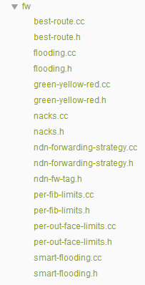
Files including forwarding strategy
ndn-stack-helper.cc 66-78,180-190
ndn-limits-rate.cc

